Slide 1
BOLSTERING TRANSPORTATION INFRASTRUCTURE: THE CHALLENGE OF CONNECTING GEOGRAPHICALLY ISOLATED REGIONS
International Conference on Research Trends in AI and IoT for Infrastructure and Industry
Ref Id : 17448

Slide 2








SYNOPSIS
Challenge
Solution
Method of solution
Results
Problems faced
Conclusion

Slide 3
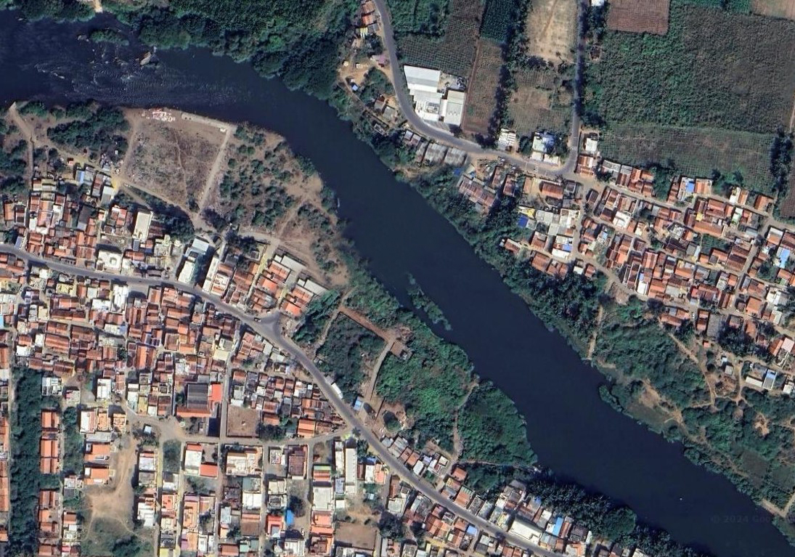

THE CHALLENGE
The problem at hand revolves around the challenge of establishing effective links between geographically distinct regions separated by small water bodies, particularly within rural landscapes.
The Project was named as “Region Connectivity”.
?

Slide 4
OUR SOLUTION AND WHAT IT DOES:
In our solution, we are planned to use image Processing with the tool Open cv with a bit of coding.
What it does :
Gives a perfect location for Bridge construction in the waterbody which separates the land mass.
When providing the location it considers the landmass, building clusters etc...

Slide 5
METHOD OF SOLUTION
Topographic map images obtained through APIs like Google Maps and Open Topography, given to OpenCV for image processing.
Image segmentation, it separates the waterbodies, building clusters, used land, unused land and vegetation from input image by grey scaling and colour separation.
With the data from the image segmentation, it compares the obtained values with some minimum building cluster values.
If values were greater than the minimum then it logically determines the location for bridge in the waterbody with building clusters on either sides.
Step 1:
Step 2:
Step 3:
Step 4:

Slide 6
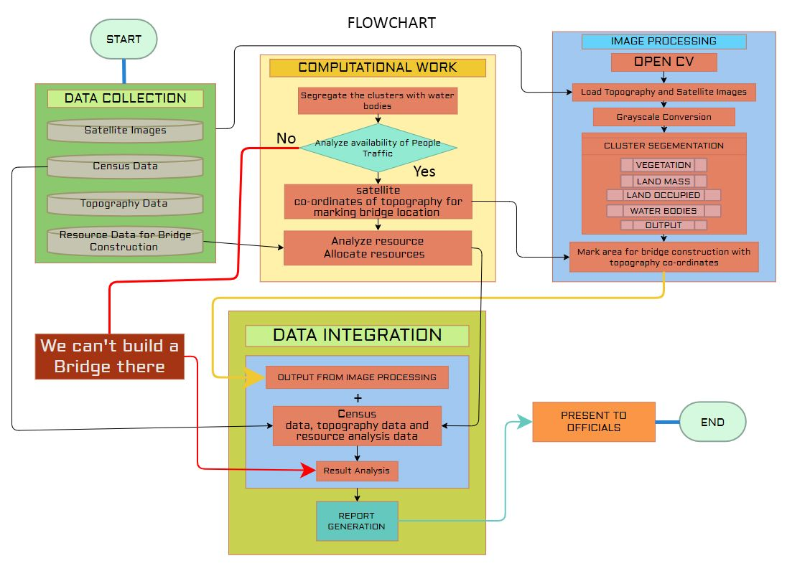

Slide 7
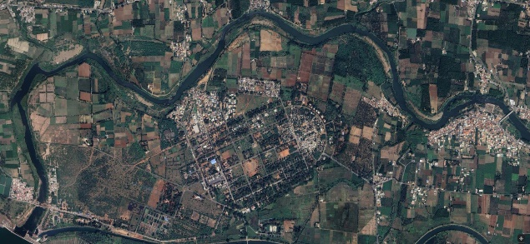
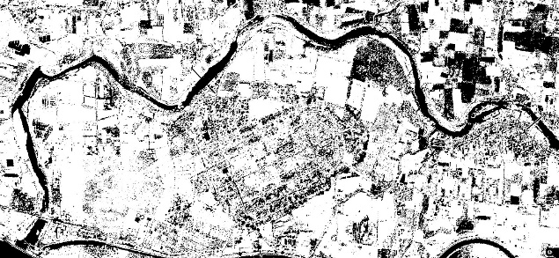
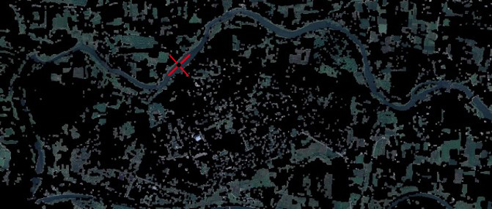
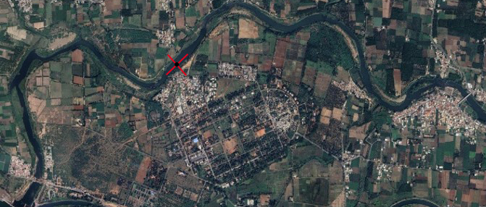
RESULTS
1
2
3
4

Slide 8
PROBLEMS FACED:
Google Maps pictures help with navigating, but building bridges needs detailed land information (topography and satellite data). This data can be hard to track down.
Even getting a Google Maps API key isn't enough for our needs. It provides good visuals, but not the specific details required for bridge construction.

Slide 9
THANK YOU

